Slide 1


Subhasree Mohapatra
01-Feb-2025

Slide 2

Outline
Executive Summary
Introduction
Methodology
Results
Conclusion
Appendix

Slide 3
Executive Summary
Summary of methodologies
•Data Collection
•Data Wrangling
•EDA with Data Visualization
•EDA with SQL
•Building an interactive map with folium
•Building a dashboard with Plotlydash
•Predictive Analysis (Classification)
Summary of all results
•EDA results
•Interactive Analysis
•Predictive Analysis

Slide 4
Introduction
Project background and context
Analyzing factors that influence rocket missions and result in successful outcomes
Problems you want to find answers
Determining what factors predict successful mission outcomes

Slide 5

Section 1

Slide 6
Methodology
Executive Summary
Data collection methodology:
•Using REST Apis
•Using Beautiful Soup package to web scrape HTML tables
•Perform data wrangling
•Cleaning, transforming & structuring raw data into a useable format by handling missing values, removing duplicates and correcting inconsistencies.
•Perform exploratory data analysis (EDA) using visualization and SQL
•Perform interactive visual analytics using Folium and PlotlyDash
•Perform predictive analysis using classification models
•Build a machine learning pipeline, determine model with best accuracy, output the confusion matrix

Slide 7
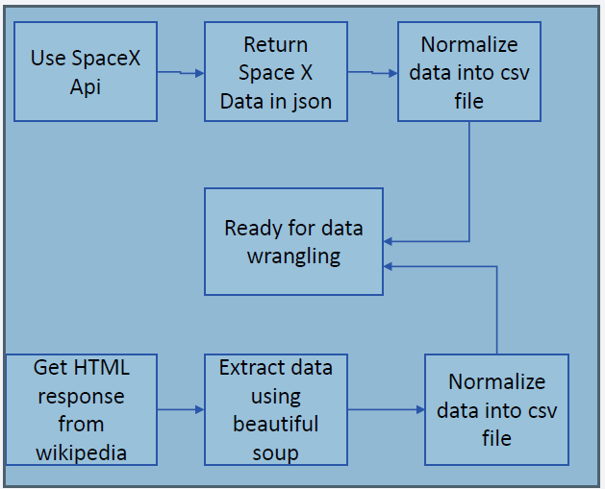
Data Collection
Data Collection steps -
•Gather data from Space X REST Api
•API will give data about launches, rockets used,
payload delivered, launch specification, landing specification
and landing outcome.
•Another popular data source is web scrapping using
Beautiful Soup

Slide 8
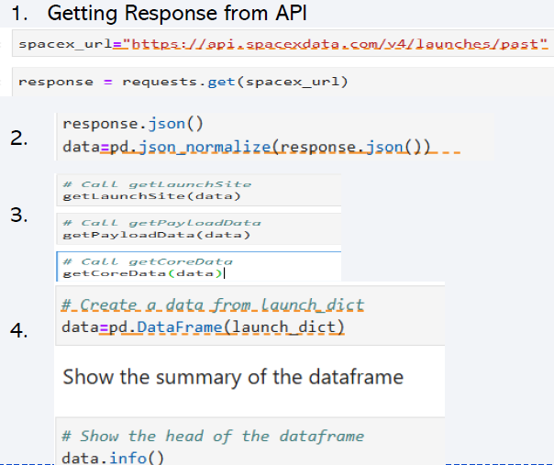
Data Collection – SpaceX API
Present your data collection with SpaceX REST calls using key phrases and flowcharts
Add the GitHub URL
https://github.com/smoha-git/Firstrepo/blob/main/jupyter-labs-spacex-data-collection-api.ipynb

Slide 9
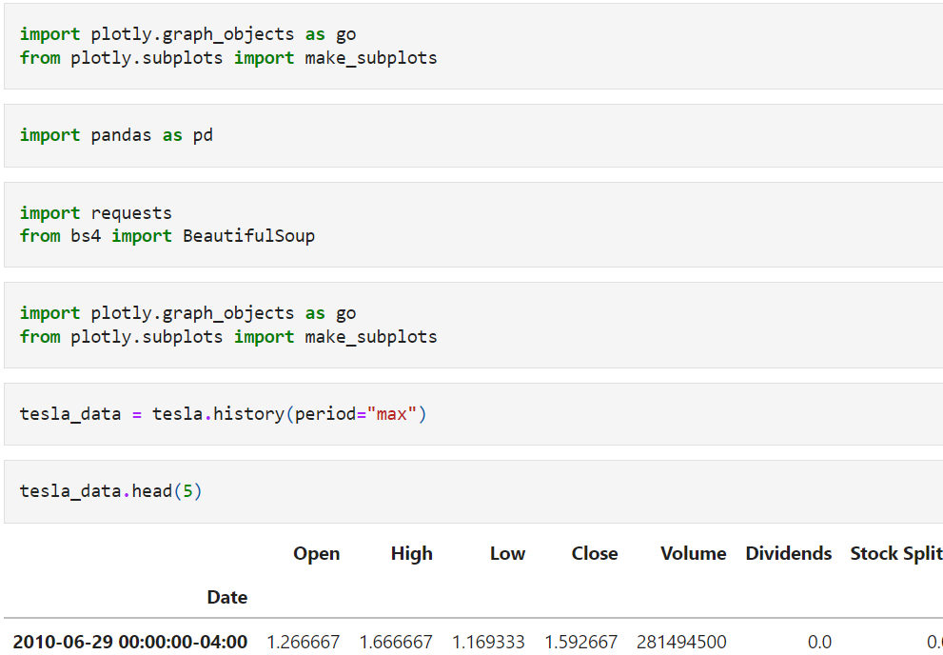
Data Collection - Scraping
Present your web scraping process using key phrases and flowcharts
Add the GitHub URL of the completed web scraping notebook, as an external reference and peer-review purpose
https://github.com/smoha-git/Firstrepo/blob/main/Webscraping_Subhasree.ipynb

Slide 10
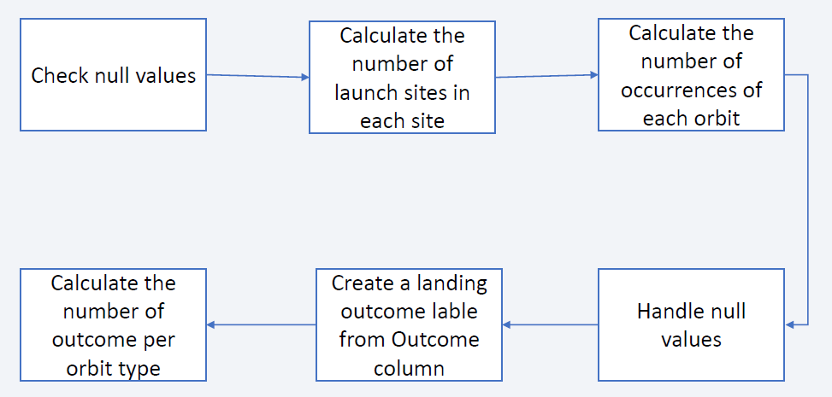
Data Wrangling
Describe how data were processed
Add the GitHub URL
https://github.com/smoha-git/Firstrepo/blob/main/labs-jupyter-spacex-Data%20wrangling.ipynb

Slide 11
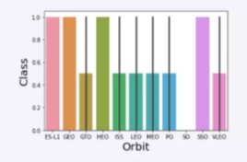
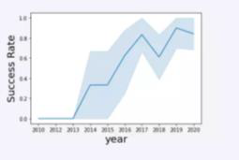
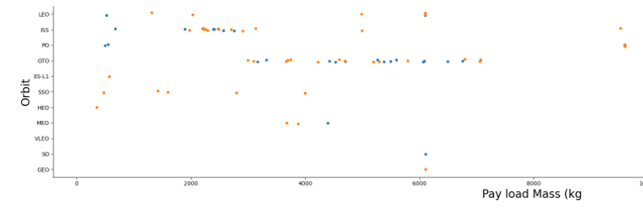
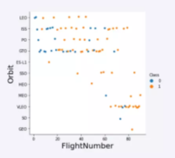
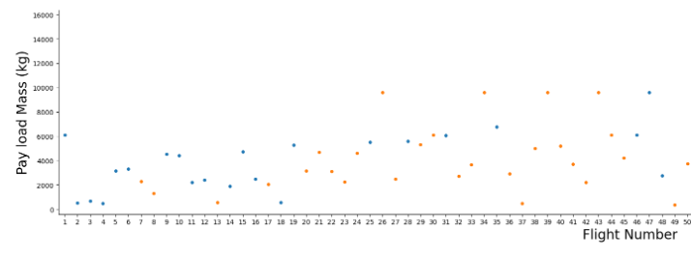
EDA with Data Visualization
https://github.com/smoha-git/Firstrepo/blob/main/edadataviz.ipynb

Slide 12
EDA with SQL
SQL queries performed:
Create table from another table
Select Distinct
Applied Where, Limit, and Between conditional clauses
Aggregation functions like Sum, Count and Average
https://github.com/smoha-git/Firstrepo/blob/main/jupyter-labs-eda-sql-coursera_sqllite.ipynb

Slide 13
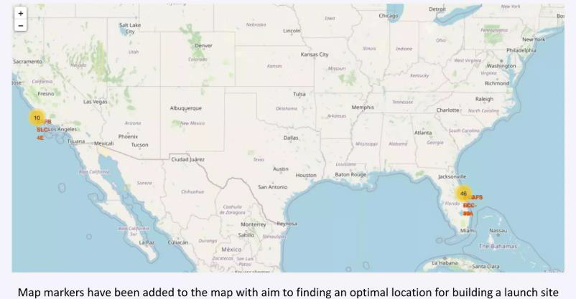
Build an Interactive Map with Folium

Slide 14
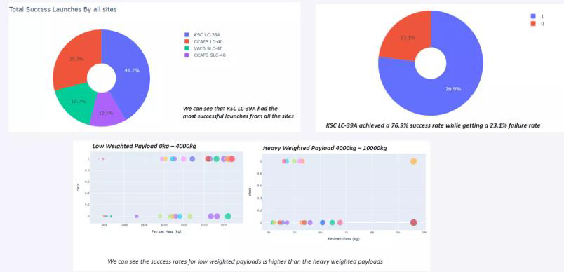
Build a Dashboard with Plotly Dash

Slide 15
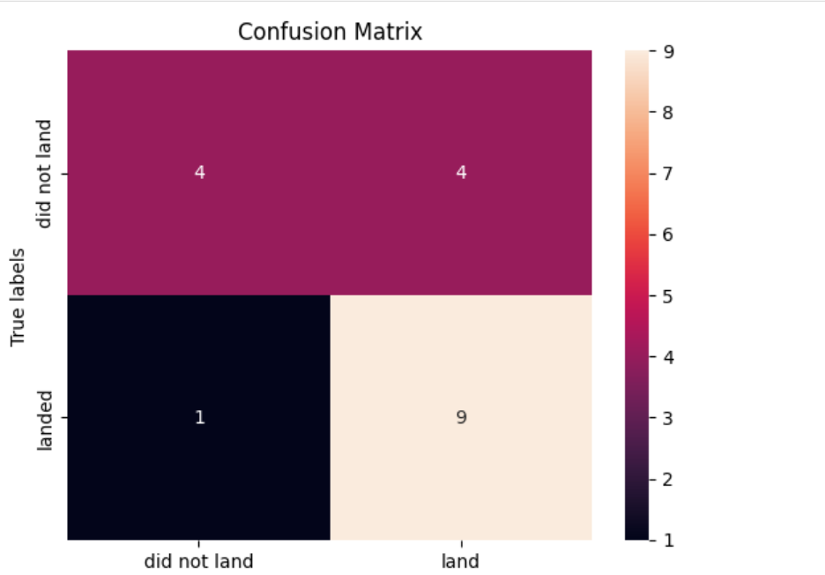
Predictive Analysis (Classification)
Built, evaluated, improved, and found the best performing classification model
Applied a standardScaler() function to preprocess data
Split the data into training and testing samples
Applied GridSearch to find the best hyperparameters for different classification models
Evaluated the various models’ accuracy and analysed the confusion matrix
https://github.com/smoha-git/Firstrepo/blob/main/SpaceX_Machine%20Learning%20Prediction_Part_5.ipynb

Slide 16
Results
Exploratory data analysis results
Interactive analytics demo in screenshots
Predictive analysis results

Slide 17

Section 2

Slide 18
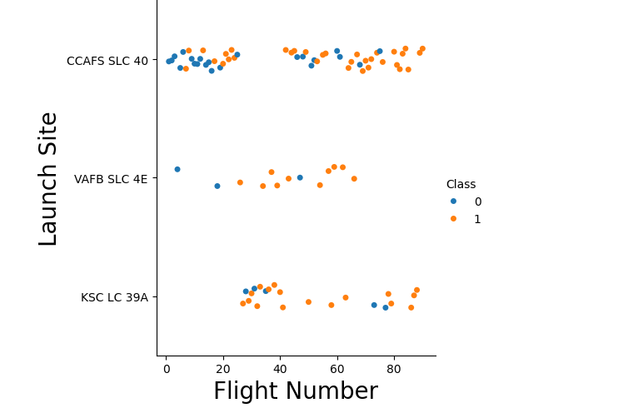
Flight Number vs. Launch Site
Launches from CCAFS SLC 40 are higher in number and higher chances of success

Slide 19
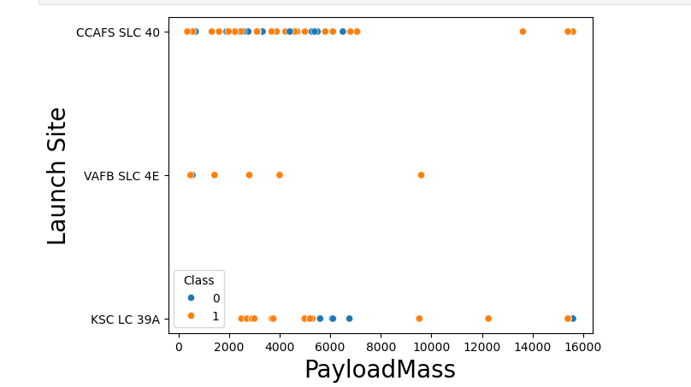
Payload vs. Launch Site
CCAFS SLC 40 has launched majority with payload mass

Slide 20
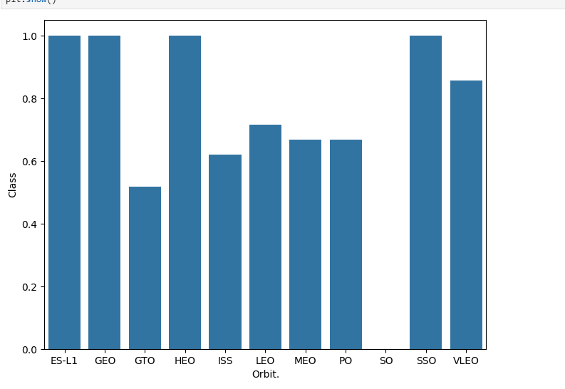
Success Rate vs. Orbit Type
ES-L1, GEO, HEO & SSO are among the highest success rate

Slide 21
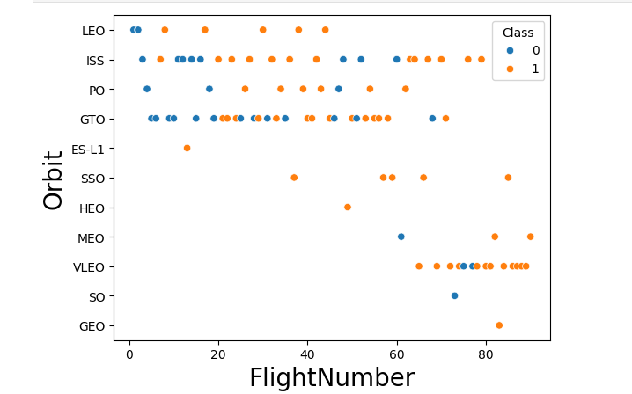
Flight Number vs. Orbit Type
Towards the end, all orbit types showed successful outcomes as the flight numbers increased, VLEO has a different trend

Slide 22
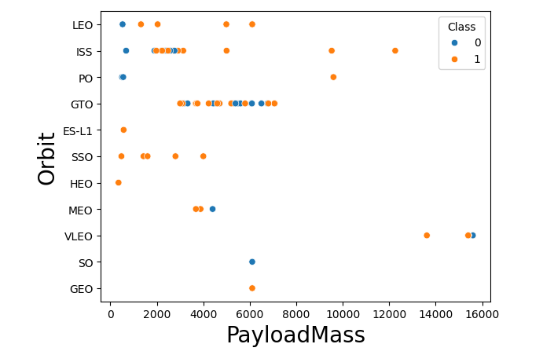
Payload vs. Orbit Type
Higher payloads showed better results across
most orbit types for mission success

Slide 23
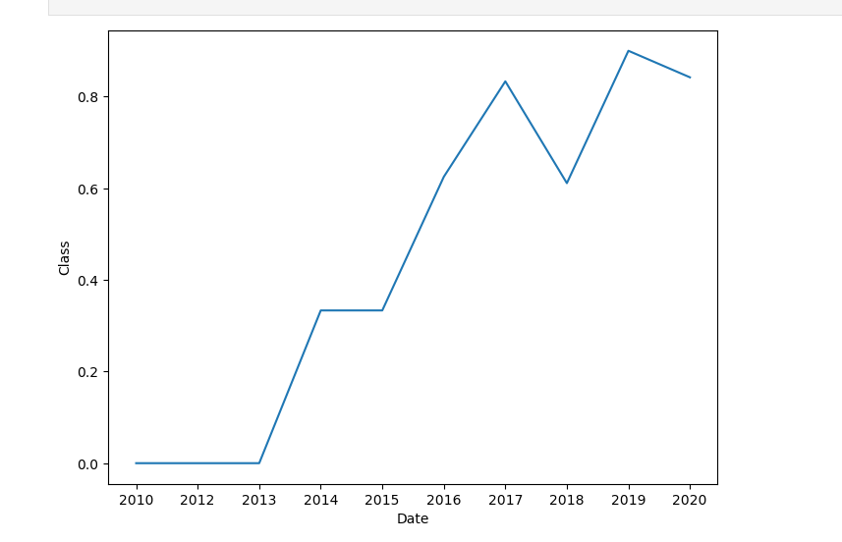
Launch Success Yearly Trend
The success rate since 2013 kept increasing till 2020

Slide 24
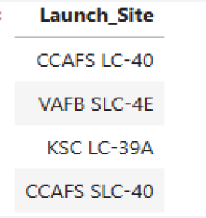
All Launch Site Names
%sql SELECT DISTINCT Launch_Site FROM SPACEXTABLE

Slide 25
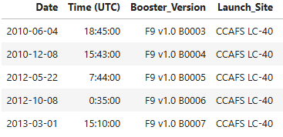
Launch Site Names Begin with 'CCA'
%sql SELECT * FROM SPACEXTABLE WHERE Launch_Site LIKE "CCA%" LIMIT 5

Slide 26
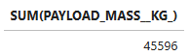
Total Payload Mass
%sql SELECT SUM(PAYLOAD_MASS__KG_) FROM SPACEXTABLE WHERE Customer="NASA (CRS)"

Slide 27
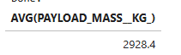
Average Payload Mass by F9 v1.1
%sql SELECT AVG(PAYLOAD_MASS__KG_) FROM SPACEXTABLE WHERE Booster_Version="F9 v1.1"

Slide 28

First Successful Ground Landing Date
%sql SELECT Date FROM SPACEXTABLE WHERE Landing_Outcome="Success (ground pad)" LIMIT 1

Slide 29
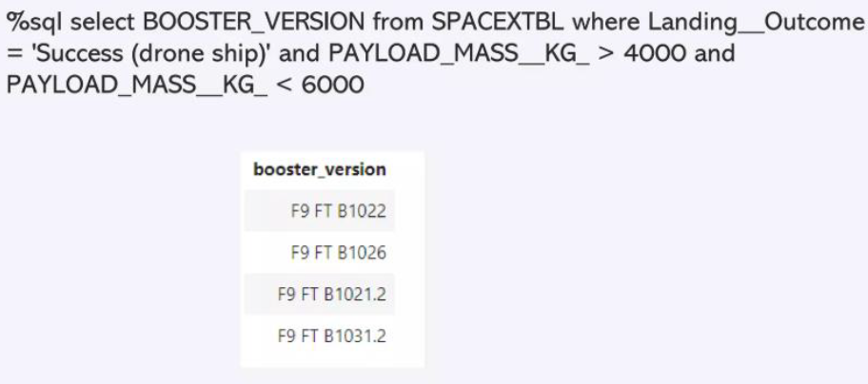
Successful Drone Ship Landing with Payload between 4000 and 6000

Slide 30
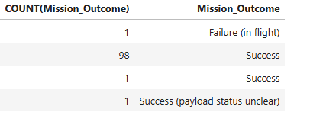
Total Number of Successful and Failure Mission Outcomes
%sql SELECT COUNT(Mission_Outcome), Mission_Outcome FROM SPACEXTABLE GROUP BY Mission_Outcome

Slide 31
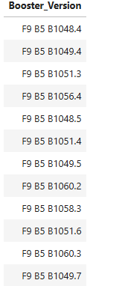
Boosters Carried Maximum Payload
%sql SELECT Booster_Version FROM SPACEXTABLE WHERE PAYLOAD_MASS__KG_=(SELECT MAX(PAYLOAD_MASS__KG_) FROM SPACEXTABLE)

Slide 32
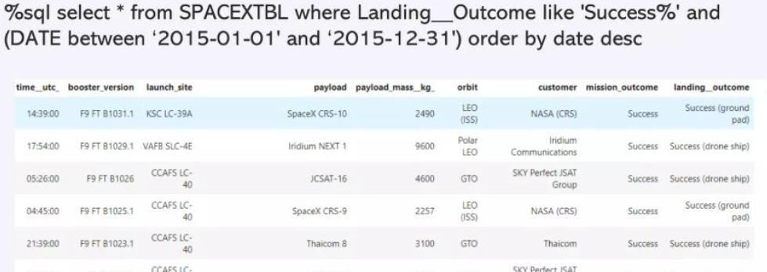
2015 Launch Records

Slide 33
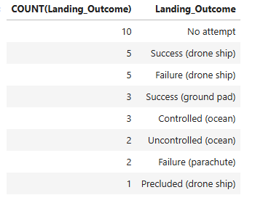
Rank Landing Outcomes Between 2010-06-04 and 2017-03-20
%sql SELECT COUNT(Landing_Outcome), Landing_Outcome FROM SPACEXTABLE WHERE Date BETWEEN "2010-06-04" AND "2017-03-20" GROUP BY Landing_Outcome ORDER BY COUNT(Landing_Outcome) DESC

Slide 34

Section 3

Slide 35
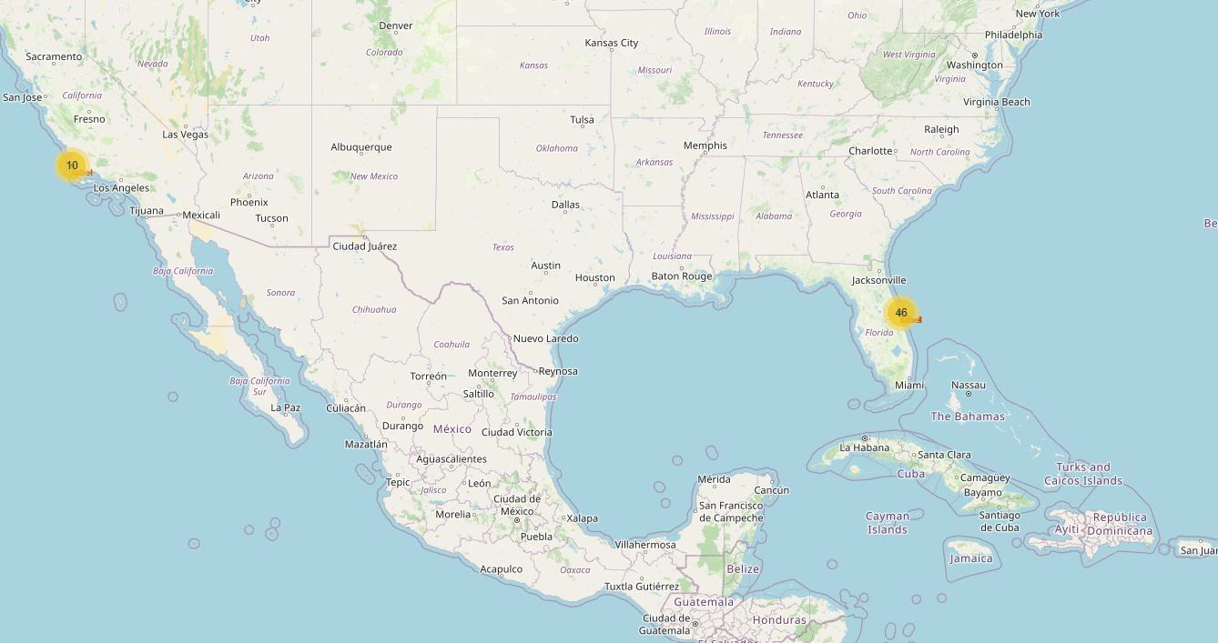
<Folium Map Screenshot 1>
Insights
The launch sites are close to the coastal regions.
The launch sites are on similar latitudes

Slide 36
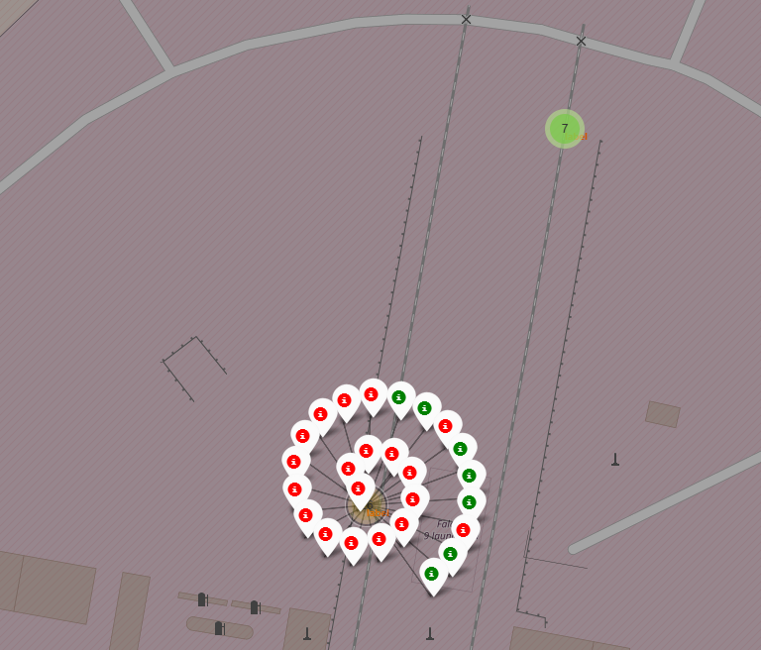
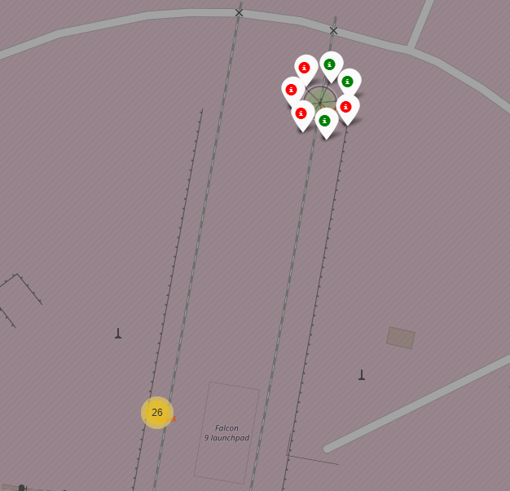
<Folium Map Screenshot 2>
Insights
The two launch sites on the east coast had more failed launches than successful launches.
This is possibly due to the fact that initial launches failed and over time they improved

Slide 37
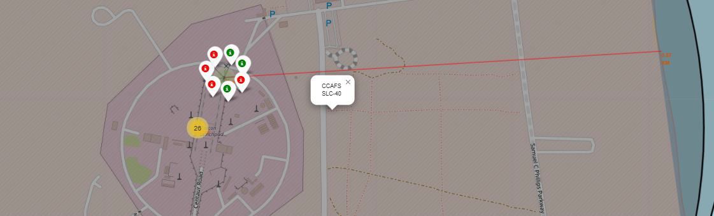
<Folium Map Screenshot 3>
Launch site CCAFS SLC-40 is 0.87km from the coastline

Slide 38

Section 4

Slide 39

<Dashboard Screenshot 1>

Slide 40
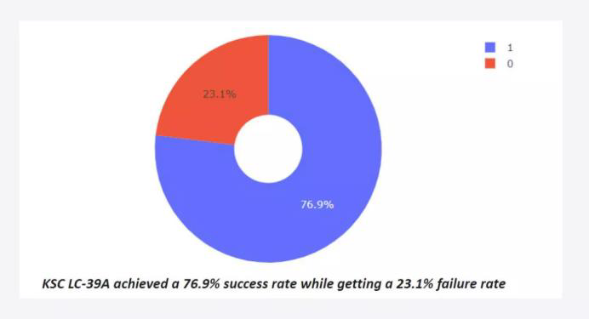
<Dashboard Screenshot 2>

Slide 41
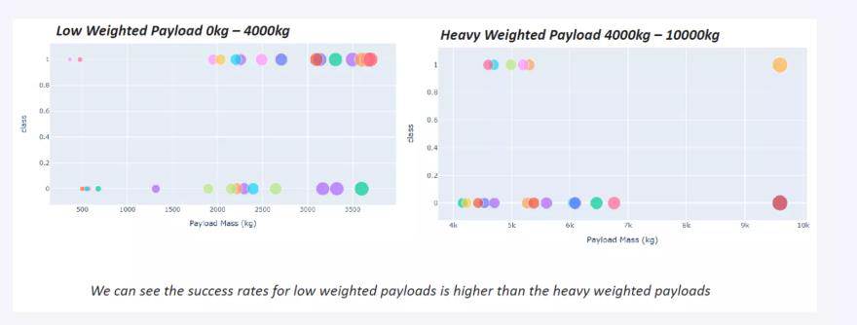
<Dashboard Screenshot 3>

Slide 42

Section 5

Slide 43
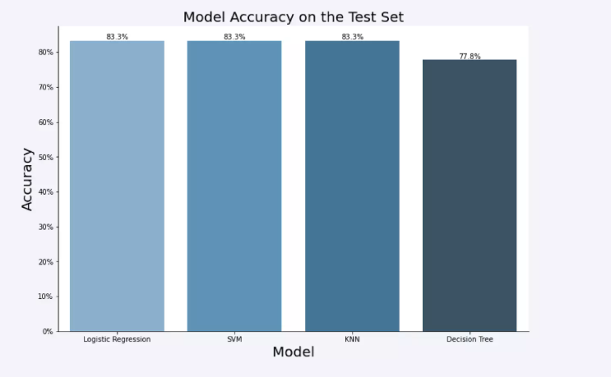
Classification Accuracy

Slide 44
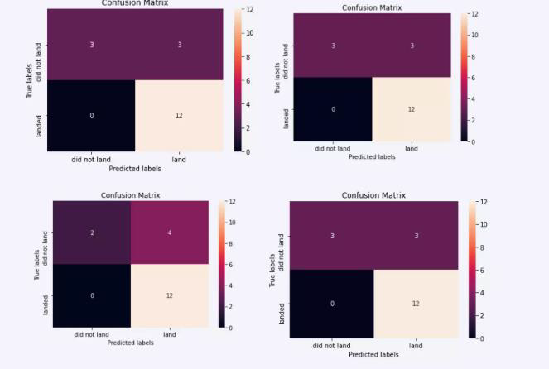
Confusion Matrix

Slide 45
Conclusions
There is plenty of SpaceX launch data available online
The two launch sites on the east coast had more failed launches than successful launches.
The KSC LC -39A launch site had the highest success rate
The decision tree was the best model for classification purposes

Slide 46
Appendix
Include any relevant assets like Python code snippets, SQL queries, charts, Notebook outputs, or data sets that you may have created during this project

Slide 47


